Slide 1

COMFORT WITH ROLL MOTION
Mechanical Vibration
Academic Year: 2020/2021
Prof. F. Pellicano
Prof. A. Zippo
Ass. G. Iarriccio
Group D:
Juan Sebastian Cepeda Munevar
Giacomo Chinni
Giovanni Coppola
Francesco Cuius Iuculano
Marco Cunaccia
Giacomo Davanzo
Edoardo d’Amicis
Denis Tonini

Slide 2
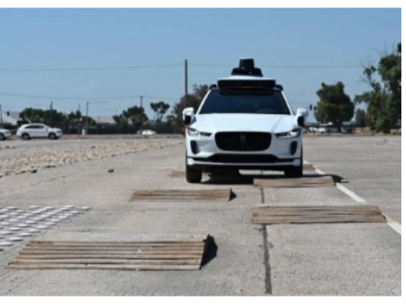
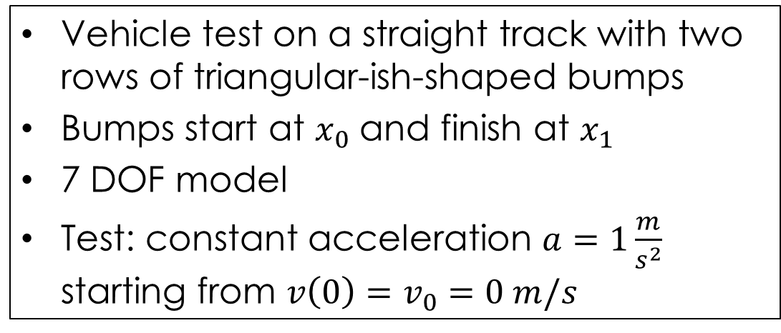
INTRODUCTION
Vehicle test on a straight track with two rows of triangular-ish-shaped bumps
Bumps start at $x_{0}$ and finish at $x_{1}$
7 DOF model
Test: constant acceleration $a=1\frac{m}{s^{2}}$ starting from $v\left(0\right)=v_{0}=0 m/s$

Slide 3
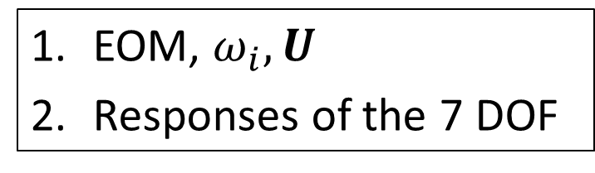
TARGETS
EOM, $ω_{i}, U$
Responses of the 7 DOF
Both the points with and without the anti-roll bar hence comparison of the two situations.

Slide 4
WHAT WE HAVE DONE
MODAL ANALYSIS: damped and undamped free response
EOM resolution, DUNCAN APPROACH
EOM resolution, DIRECT APPROACH
#All the 3 passages with and without anti-roll bar#
4. Comparison between various results

Slide 5
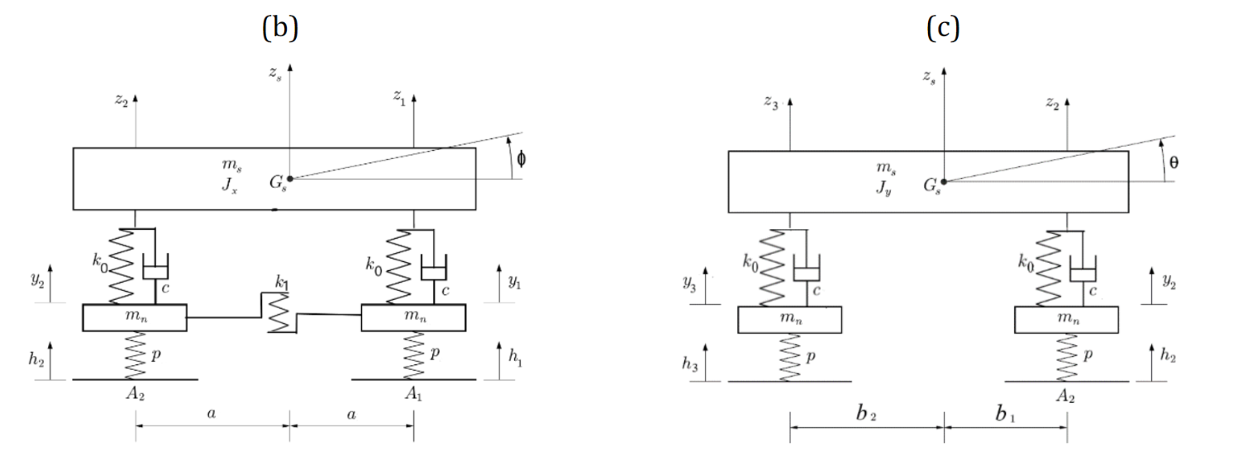
MODEL
z_{s}(t) | Car body’s COG vertical position | k₀ | Springs stiffness
ϕ(t) | Roll angle | k₁ | Front anti-roll bar stiffness
θ(t) | Pitch angle | c | Damping coefficient
m_{s} | Sprung mass | m_{n} | Unsprung mass per wheel
J_{x} | Inertia along longitudinal axis | a | Wheels-COG transversal distance
J_{y} | Inertia along transversal axis | b₁ | Front wheels-COG distance
z_{i}(t) | Car body’s suspension joints | b₂ | Rear wheels-COG distance
h_{i}(t) | Road vertical position | p | Tyres stiffness
y_{i}(t) | Wheel vertical position

Slide 6
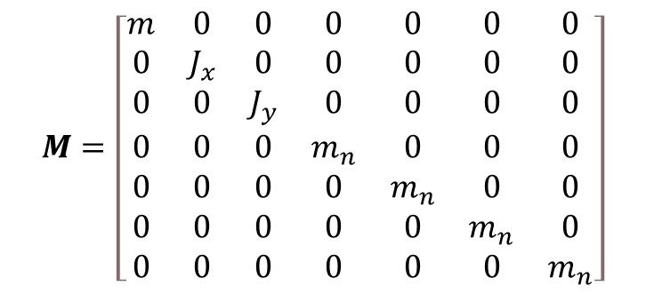
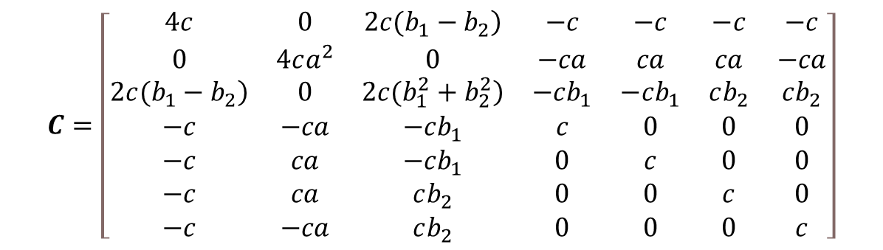
EOM MATRICES
$$M=\left[\begin{matrix}m & 0 & 0 & 0 & 0 & 0 & 0 \\ 0 & J_{x} & 0 & 0 & 0 & 0 & 0 \\ 0 & 0 & J_{y} & 0 & 0 & 0 & 0 \\ 0 & 0 & 0 & m_{n} & 0 & 0 & 0 \\ 0 & 0 & 0 & 0 & m_{n} & 0 & 0 \\ 0 & 0 & 0 & 0 & 0 & m_{n} & 0 \\ 0 & 0 & 0 & 0 & 0 & 0 & m_{n}\end{matrix}\right]$$
$$C=\left[\begin{matrix}4c & 0 & \left.2c(b_{1}−b_{2}\right) & −c & −c & −c & −c \\ 0 & 4ca^{2} & 0 & −ca & ca & ca & −ca \\ \left.2c(b_{1}−b_{2}\right) & 0 & \left.2c(b_{1}^{2}+b_{2}^{2}\right) & −cb_{1} & −cb_{1} & cb_{2} & cb_{2} \\ −c & −ca & −cb_{1} & c & 0 & 0 & 0 \\ −c & ca & −cb_{1} & 0 & c & 0 & 0 \\ −c & ca & cb_{2} & 0 & 0 & c & 0 \\ −c & −ca & cb_{2} & 0 & 0 & 0 & c\end{matrix}\right]$$

Slide 7
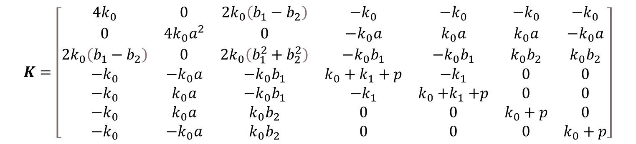

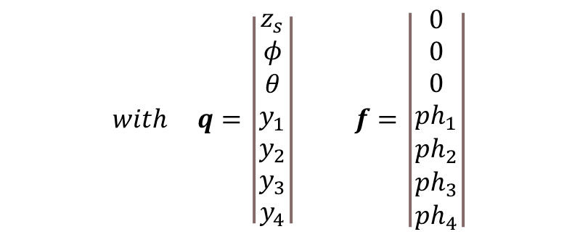
EOM MATRICES
$$K=\left[\begin{matrix}4k_{0} & 0 & 2k_{0}\left(b_{1}−b_{2}\right) & −k_{0} & −k_{0} & −k_{0} & −k_{0} \\ 0 & 4{k_{0}a}^{2} & 0 & −k_{0}a & k_{0}a & k_{0}a & −k_{0}a \\ 2k_{0}\left(b_{1}−b_{2}\right) & 0 & 2k_{0}\left(b_{1}^{2}+b_{2}^{2}\right) & −k_{0}b_{1} & −k_{0}b_{1} & k_{0}b_{2} & k_{0}b_{2} \\ −k_{0} & −k_{0}a & −k_{0}b_{1} & k_{0}+k_{1}+p & −k_{1} & 0 & 0 \\ −k_{0} & k_{0}a & −k_{0}b_{1} & {−k}_{1} & k_{0}{+k}_{1}+p & 0 & 0 \\ −k_{0} & k_{0}a & k_{0}b_{2} & 0 & 0 & k_{0}+p & 0 \\ −k_{0} & −k_{0}a & k_{0}b_{2} & 0 & 0 & 0 & k_{0}+p\end{matrix}\right]$$
$$with q=\left|\begin{matrix}z_{s} \\ φ \\ θ \\ y_{1} \\ y_{2} \\ y_{3} \\ y_{4}\end{matrix}\right| f=\left|\begin{matrix}0 \\ 0 \\ 0 \\ ph_{1} \\ ph_{2} \\ ph_{3} \\ ph_{4}\end{matrix}\right|$$
EOMs $M\ddot{q}+C\dot{q}+Kq=f$

Slide 8
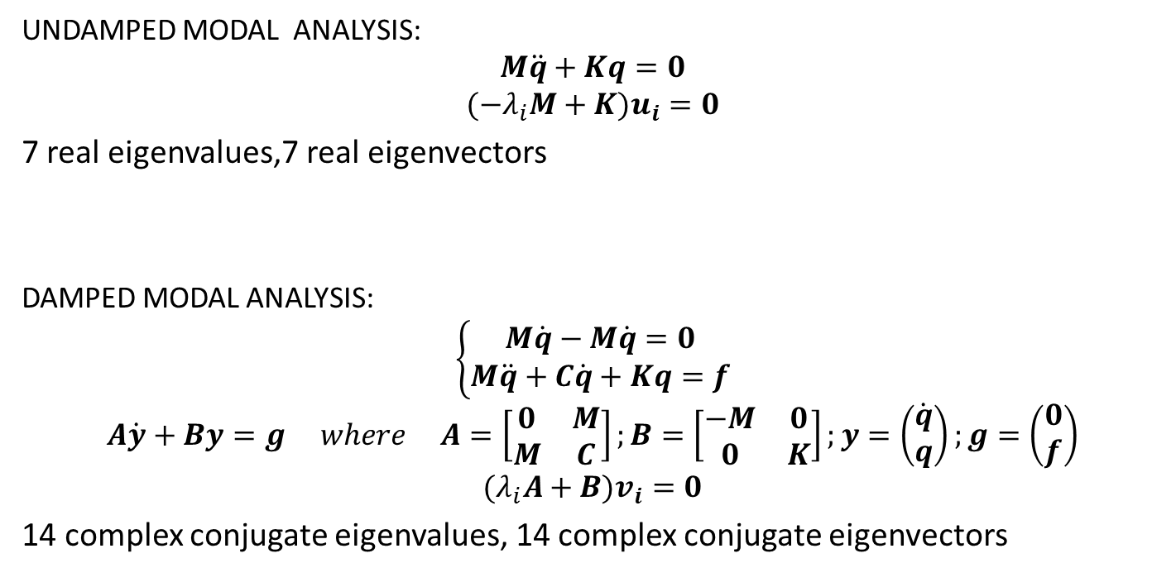
MODAL ANALYSIS
UNDAMPED MODAL ANALYSIS:
$$M\ddot{q}+Kq=0$$
$$(−λ_{i}M+K)u_{i}=0$$
7 real eigenvalues,7 real eigenvectors
DAMPED MODAL ANALYSIS:
$$\left\{\begin{aligned}M\dot{q}−M\dot{q}=0 \\ M\ddot{q}+C\dot{q}+Kq=f\end{aligned}\right.$$
$$A\dot{y}+By=g where A=\left[\begin{matrix}0 & M \\ M & C\end{matrix}\right];B=\left[\begin{matrix}−M & 0 \\ 0 & K\end{matrix}\right];y=\left(\begin{matrix}\dot{q} \\ q\end{matrix}\right);g=\left(\begin{matrix}0 \\ f\end{matrix}\right)$$
$$(λ_{i}A+B)v_{i}=0$$
14 complex conjugate eigenvalues, 14 complex conjugate eigenvectors

Slide 9
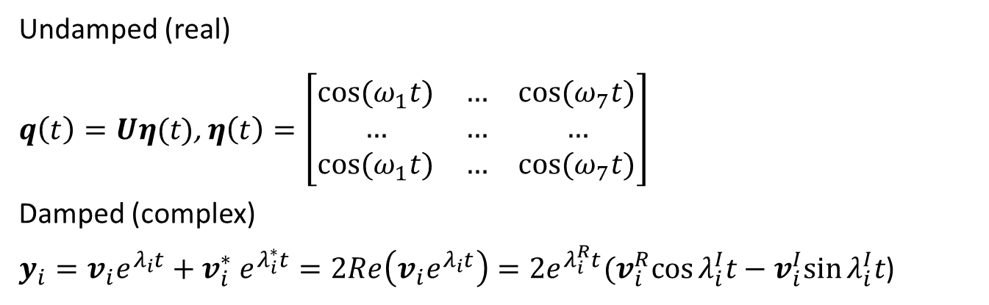
MODAL ANALYSIS: FREE RESPONSE
Undamped (real)
$q\left(t\right)=Uη(t)$, $η\left(t\right)=\left[\begin{matrix}cos⁡(ω_{1}t) & … & cos⁡(ω_{7}t) \\ … & … & … \\ cos⁡(ω_{1}t) & … & cos⁡(ω_{7}t)\end{matrix}\right]$
Damped (complex)
$y_{i}=v_{i}e^{λ_{i}t}+v_{i}^{∗} e^{λ_{i}^{∗}t}=2Re\left(v_{i}e^{λ_{i}t}\right)=2e^{λ_{i}^{R}t}(v_{i}^{R}cos⁡λ_{i}^{I}t−v_{i}^{I}sin⁡λ_{i}^{I}t$)

Slide 10
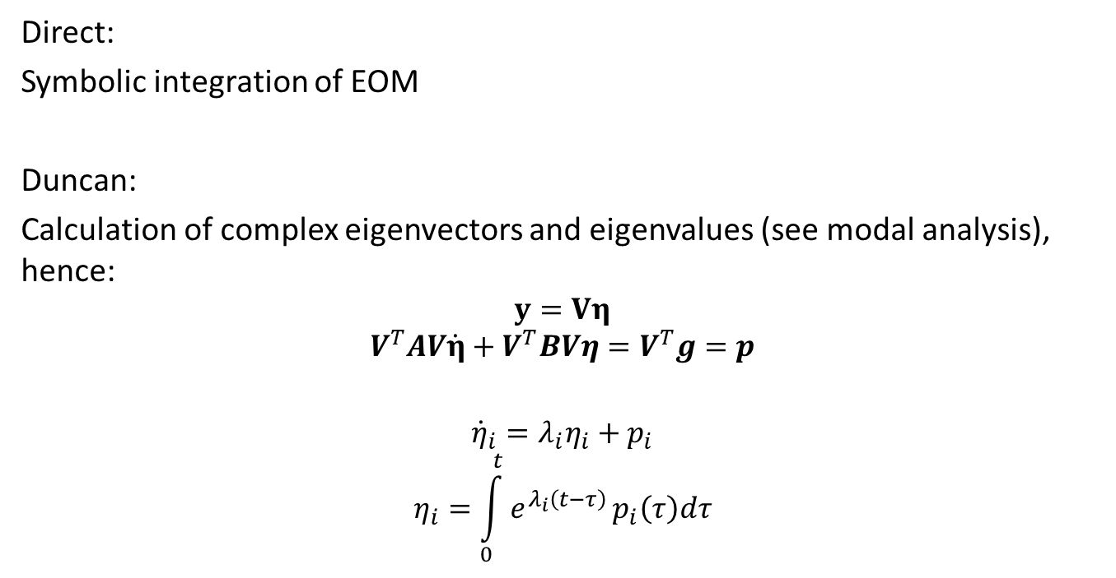
DIRECT APPROACH and DUNCAN APPROACH
Direct:
Symbolic integration of EOM
Duncan:
Calculation of complex eigenvectors and eigenvalues (see modal analysis), hence:
$$y=Vη$$
$$V^{T}AV\dot{η}+V^{T}BVη=V^{T}g=p$$
$${\dot{η}}_{i}=λ_{i}η_{i}+p_{i}$$
$$η_{i}=\int_{0}^{t}{e^{λ_{i}\left(t−τ\right)}}p_{i}\left(τ\right)dτ$$

Slide 11
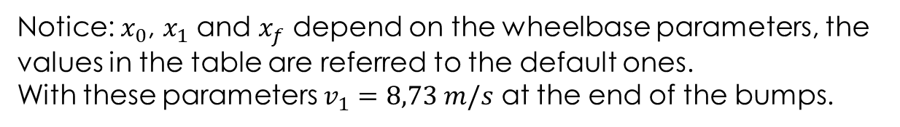
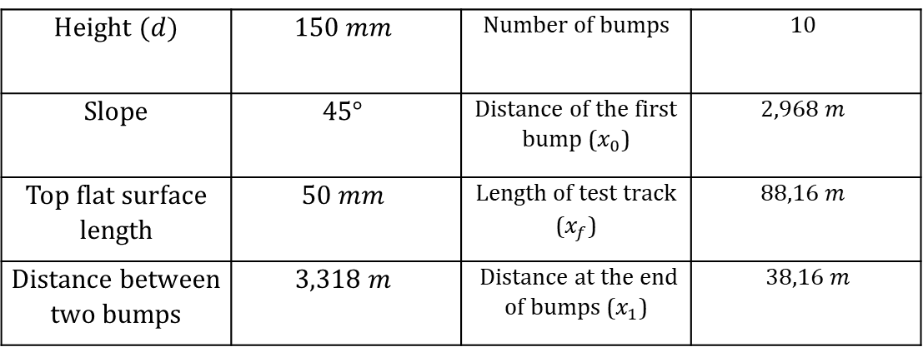
ROAD SURFACE MODELLING
Height $(d)$ | $$150 mm$$ | Number of bumps | $$10$$
Slope | $$45°$$ | Distance of the first bump ($x_{0}$) | $$2,968 m$$
Top flat surface length | $$50 mm$$ | Length of test track ($x_{f}$) | $$88,16 m$$
Distance between two bumps | $$3,318 m$$ | Distance at the end of bumps ($x_{1}$) | $38,16 m$
Notice: $x_{0}$, $x_{1}$ and $x_{f}$ depend on the wheelbase parameters, the values in the table are referred to the default ones.
With these parameters $v_{1}=8,73 m/s$ at the end of the bumps.
Duncan approach: trapezoid
Direct approach: sine approximation

Slide 12
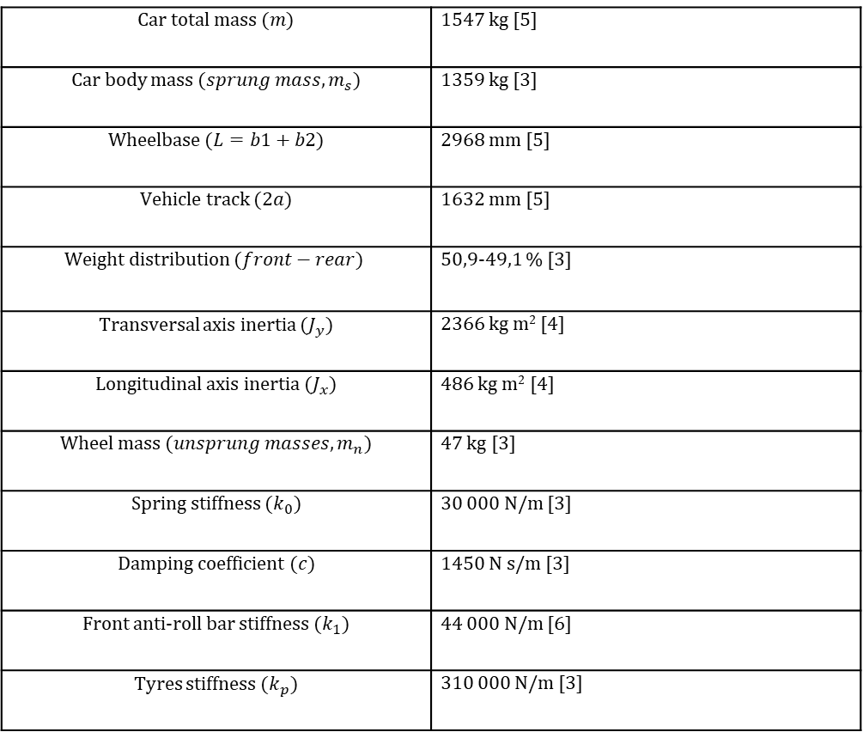
VEHICLE CHARACTERISTICS
BMW 530i (F11)
Car total mass $(m)$ | 1547 kg [5]
Car body mass $(sprung mass, m_{s})$ | 1359 kg [3]
Wheelbase $(L=b1+b2)$ | 2968 mm [5]
Vehicle track $(2a)$ | 1632 mm [5]
Weight distribution $(front−rear)$ | 50,9-49,1 % [3]
Transversal axis inertia $(J_{y})$ | 2366 kg m² [4]
Longitudinal axis inertia $(J_{x})$ | 486 kg m² [4]
Wheel mass $(unsprung masses, m_{n})$ | 47 kg [3]
Spring stiffness $(k_{0})$ | 30 000 N/m [3]
Damping coefficient $(c)$ | 1450 N s/m [3]
Front anti-roll bar stiffness $(k_{1})$ | 44 000 N/m [6]
Tyres stiffness $(k_{p})$ | 310 000 N/m [3]

Slide 13
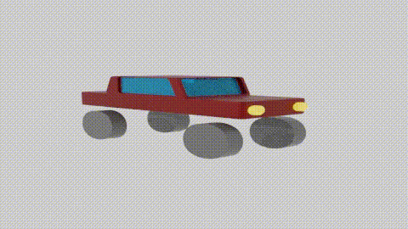
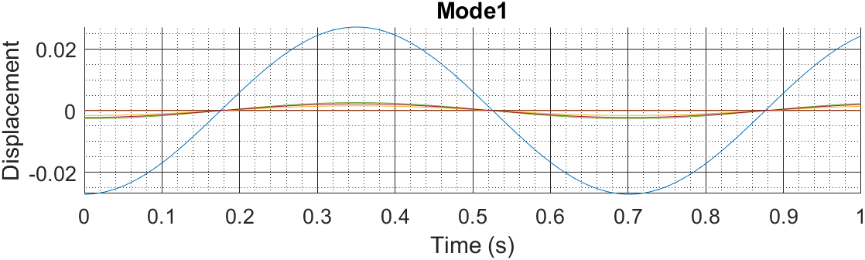
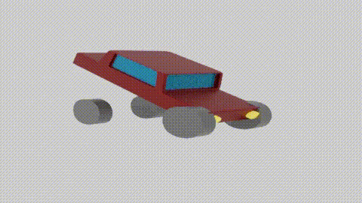
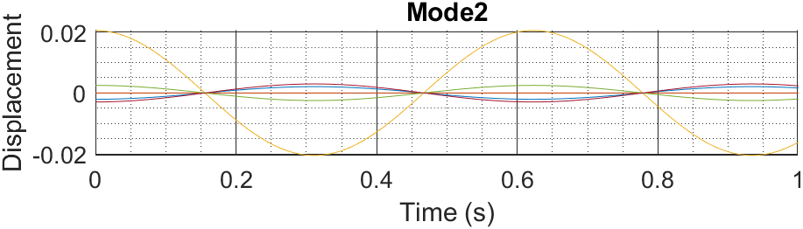
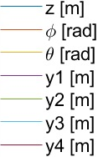
RESULTS: UNDAMPED FREE RESPONSE
With anti-roll bar
NOTICE FOR ANIMATIONS: amplification factor 10x

Slide 14
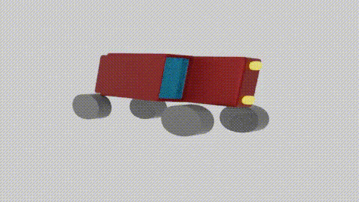
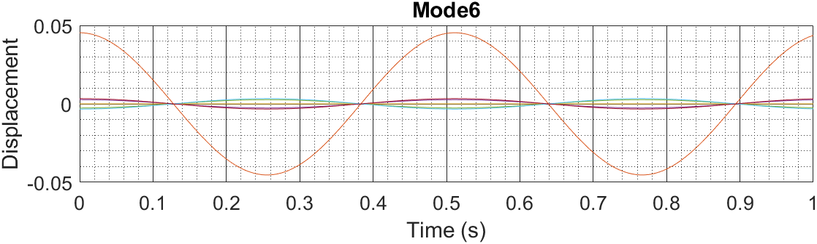
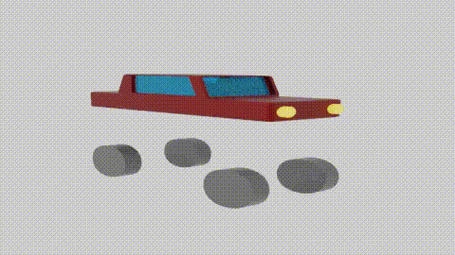
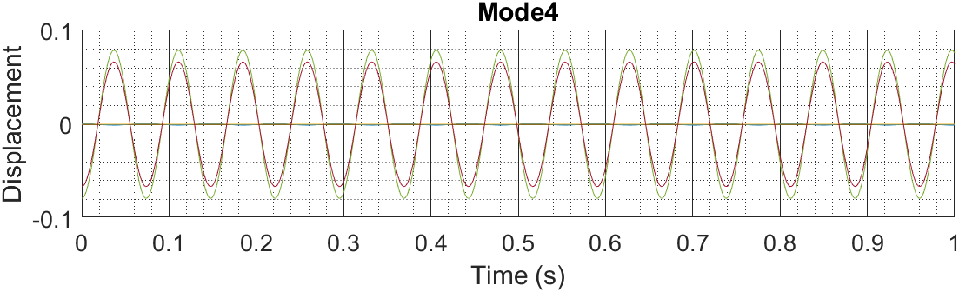
RESULTS: UNDAMPED FREE RESPONSE
With anti-roll bar

Slide 15
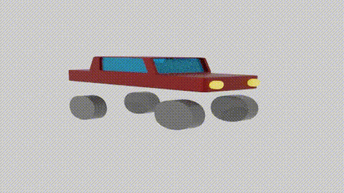
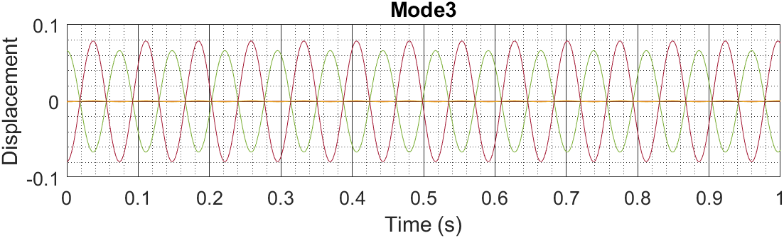
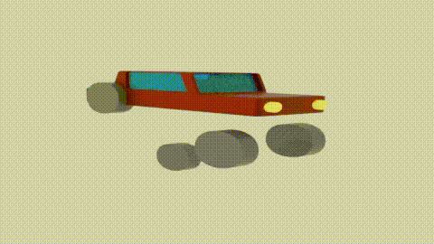
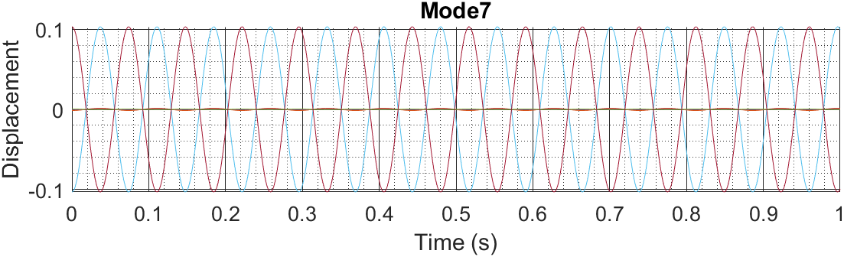
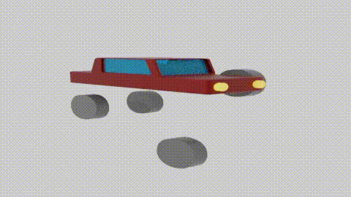
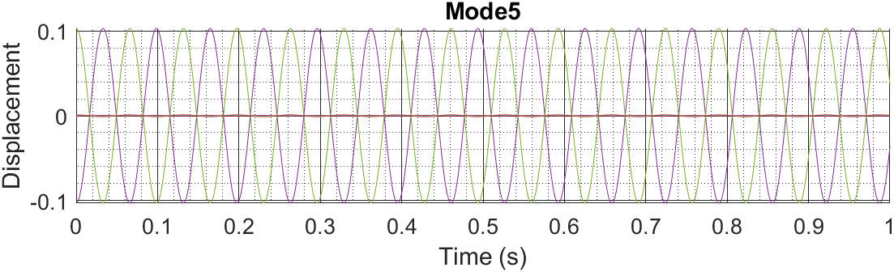
RESULTS: UNDAMPED FREE RESPONSE
With anti-roll bar

Slide 16
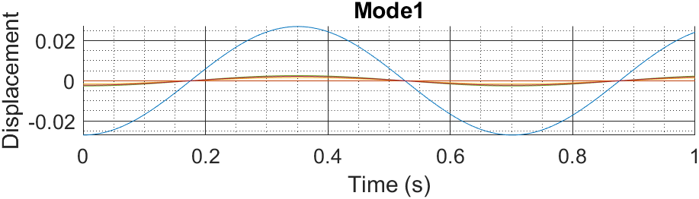
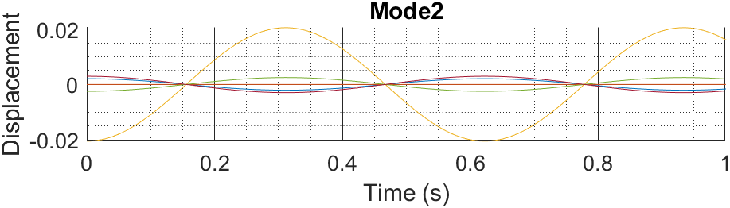
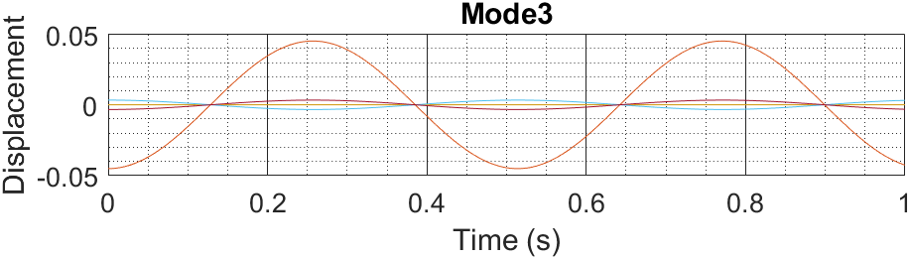
RESULTS: UNDAMPED FREE RESPONSE
Without anti-roll bar

Slide 17
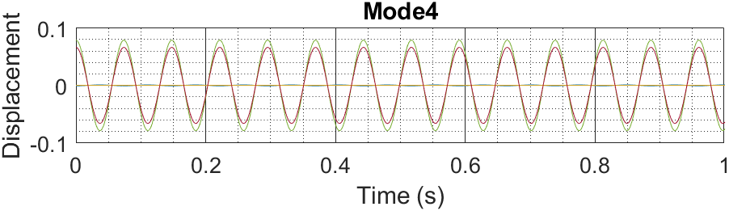
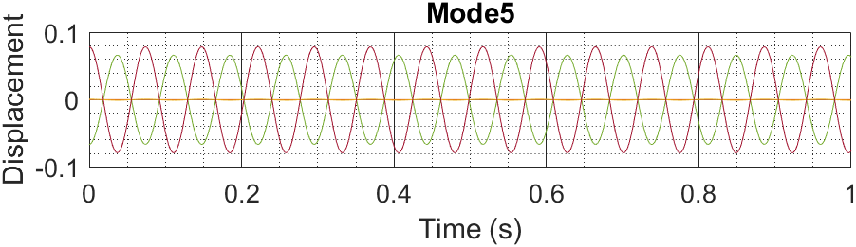
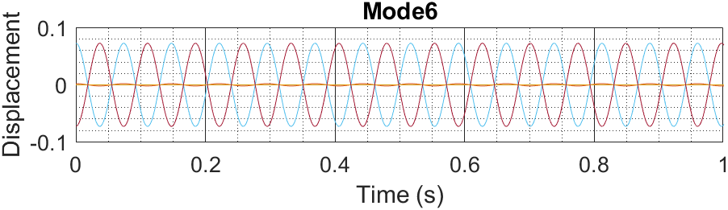
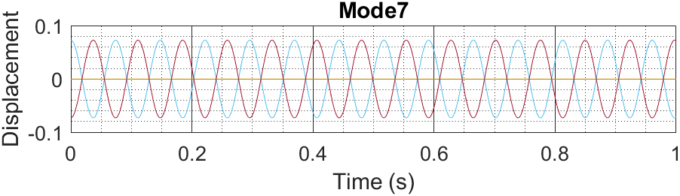
RESULTS: UNDAMPED FREE RESPONSE
Without anti roll-bar

Slide 18
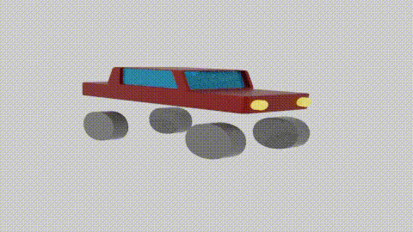
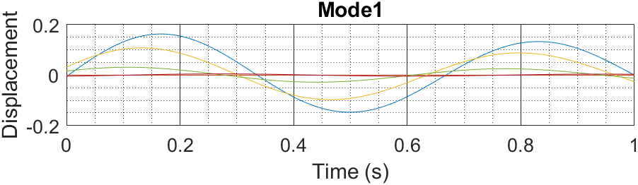
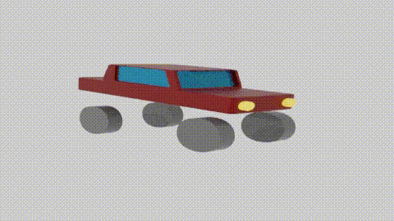
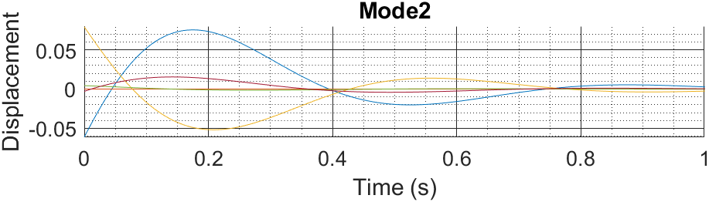
RESULTS: DAMPED FREE RESPONSE
With anti-roll bar

Slide 19
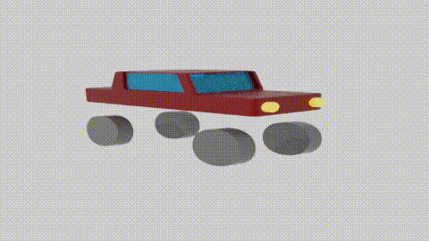
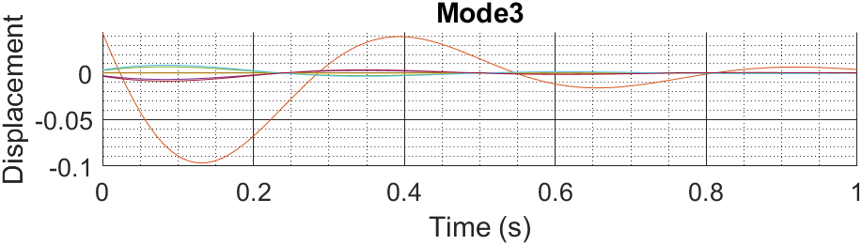
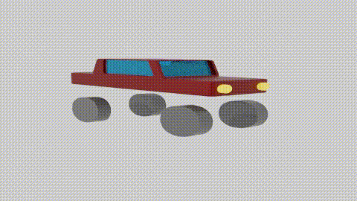
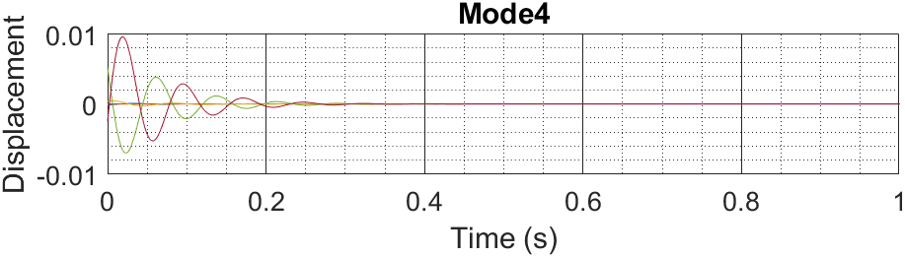
RESULTS: DAMPED FREE RESPONSE
With anti-roll bar

Slide 20
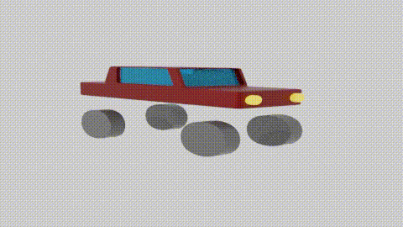
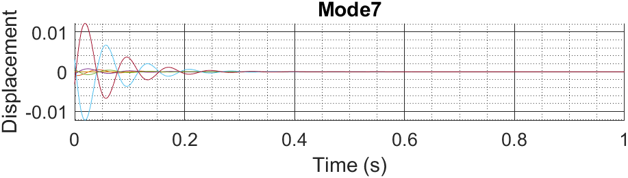
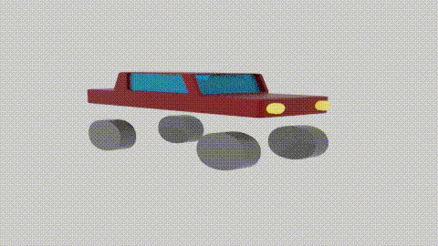
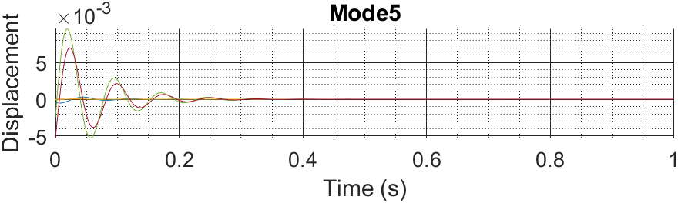
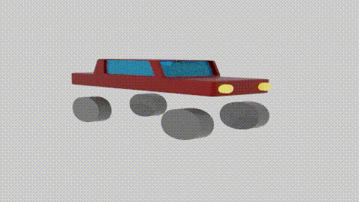
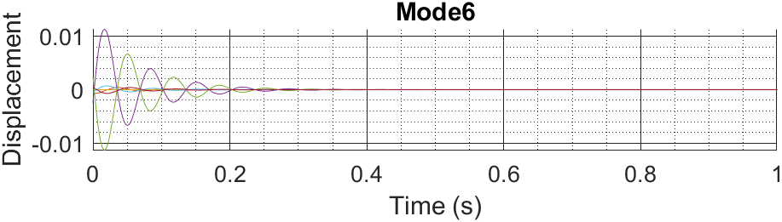
RESULTS: DAMPED FREE RESPONSE
With anti-roll bar

Slide 21

RESULTS: DAMPED FREE RESPONSE
Without anti-roll bar

Slide 22



RESULTS: DAMPED FREE RESPONSE
Without anti-roll bar

Slide 23


RESULTS: DUNCAN APPROACH
With anti-roll bar

Slide 24



RESULTS: DUNCAN APPROACH
With anti-roll bar

Slide 25


RESULTS: DUNCAN APPROACH
Without anti-roll bar

Slide 26



RESULTS: DUNCAN APPROACH
Without anti-roll bar

Slide 27


COMPARISON DUNCAN APPROACH
With anti-roll bar
Without anti-roll bar

Slide 28
COMPARISON DUNCAN APPROACH
With anti-roll bar
Without anti-roll bar

Slide 29
RESULTS: DIRECT APPROACH
With anti-roll bar

Slide 30
RESULTS: DIRECT APPROACH
With anti-roll bar

Slide 31
RESULTS: DIRECT APPROACH
Without anti-roll bar

Slide 32



RESULTS: DIRECT APPROACH
Without anti-roll bar

Slide 33


COMPARISON: DUNCAN vs DIRECT, WITH ANTI-ROLL BAR
Direct
Duncan

Slide 34

CONCLUSIONS
Modal analysis: free-response with damped and undamped animation, with and without anti-roll bar.
Response’s animation of the undamped with anti-roll bar: different DOF vibrate with different amplitudes at different $ω_{i},$ different modes of vibration visible in the animations.
Duncan resolution with and without anti-roll bar:
with the anti-roll bar: front wheels displacements $y_{1}, y_{2}$are more linked.
with the anti-roll bar: less rolling and more even displacements of the front tyres, in particular the first one.
Direct resolution with and without anti-roll bar: sine approximate bumps for symbolic resolution (needed due to ode45 limitations).
Comparison between the two resolutions, slightly different results due to slightly different bumps.

Slide 35
FURTHER DEVELOPMENTS
Different front/rear damping and stiffness
Different compression/extension damping
Different front/rear unsprung masses (wheels, brakes, suspensions)
Not laterally centered centre of gravity
Anti-roll bar: torsional bar from wheel to chassis
Damping coefficient also in the tyres

Slide 36
Any questions?
Inserire qui il logo dell’Ateneo/azienda di appartenenza
Thank you

Slide 37
REFERENCES
[1] B. Cebolla Bono, “Modelado y Caracterización de Sistemas de Suspensión
en Vehículos Automóviles”, Universitat Politècnica de València, 2017
[2] Francesco Pellicano, “Mechanical Vibrations”, 2020
[3] T.P.J. van der Sandea, B.L.J. Gysenb, I.J.M. Besselinka, J.J.H. Paulidesb, E.A.
Lomonovab, H. Nijmeijer, “Robust control of an electromagnetic active
suspension system: Simulations and measurements”, Eindhoven
University of Technology, 2013
[4] Dongchan Lee, “Summary of Typical Vehicle Parameters Measurements”, 2018
[5] BMW 5 Series (F10)-Wikipedia
[6] Zhong-Xing Li, Rong-Zhou Xu, Hong Jiang, “Roll Stiffness Optimization for Anti-
roll Bar in Interconnected Air Suspension”, Jiangsu University, 2016

